Slide 1
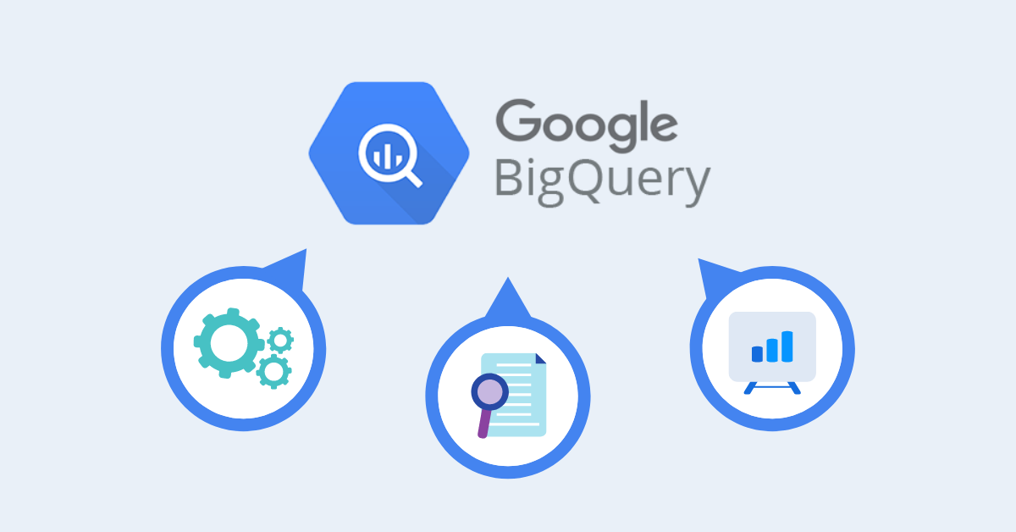
Google BigQuery – In Depth
By - Abhishek Batra – Data Architect

Slide 2
Section 1:- BigQuery Design
Datasets

Slide 3
Datasets
A dataset is contained within a specific project.
Datasets are top-level containers that are used to organize and control access to your tables and views.
A table or view must belong to a dataset, so you need to create at least one dataset before loading data into BigQuery.
Use the format projectname.datasetname to fully qualify a dataset name when using GoogleSQL, or the format projectname:datasetname to fully qualify a dataset name when using the bq command-line tool.
The storage billing model is set at the dataset level. Defaults to using logical storage billing.
The storage billing model you choose determines your storage pricing.
The storage billing model you choose doesn't impact BigQuery performance.

Slide 4
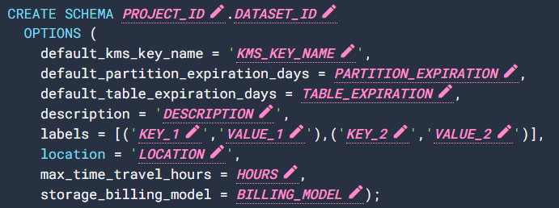
Create, List and Update Datasets
You can create, list and update datasets in the following ways:
Using the Google Cloud console.
Using a SQL query.
Using the bq mk command in the bq command-line tool.
Calling the datasets.insert API method.
Using the client libraries.
Copying an existing dataset.
Refer this URL for samples.

Slide 5
Dataset Data Replication
When you create a dataset in BigQuery, you select the region or multi-region where the data is stored.
Your data is stored in one of the contained regions and is not replicated within the multi-region.
BigQuery always stores copies of your data in two different Google Cloud zones within the dataset location.
A zone is a deployment area for Google Cloud resources within a region. In all regions, replication between zones uses synchronous dual writes.
Selecting a multi-region location does not provide cross-region replication or regional redundancy, so there is no increase in dataset availability in the event of a regional outage. Data is stored in a single region within the geographic location.
If you replicate a dataset, BigQuery stores the data in the region that you specify.
Primary region. When you first create a dataset, BigQuery places the dataset in the primary region.
Secondary region. When you add a dataset replica, BigQuery places the replica in the secondary region.
Replication Code Sample HERE.

Slide 6
Dataset Data Retention
Time Travel
Fail Safe
You can access data from any point within the time travel window, which covers the past seven days by default.
Time travel lets you query data that was updated or deleted, restore a table or dataset that was deleted, or restore a table that expired.
You can set the duration of the time travel window, from a minimum of two days to a maximum of seven days. Seven days is the default
Time travel Code HERE.
BigQuery provides a fail-safe period.
During the fail-safe period, deleted data is automatically retained for an additional seven days after the time travel window, so that the data is available for emergency recovery.
Data is recoverable at the table level. Data is recovered for a table from the point in time represented by the timestamp of when that table was deleted.
The fail-safe period is not configurable.

Slide 7
Tables
A BigQuery table contains individual records organized in rows. Each record is composed of columns (also called fields).
Every table is defined by a schema that describes the column names, data types, and other information.
Use the format projectname.datasetname.tablename to fully qualify a table name when using GoogleSQL, or the format projectname:datasetname.tablename to fully qualify a table name when using the bq command-line tool.
The following sections describe the table types that BigQuery supports.
Standard BigQuery tables: structured data stored in BigQuery storage.
External tables: tables that reference data stored outside BigQuery.
Views: logical tables that are created by using a SQL query.

Slide 8
Specify Table Schema
When you load data or create an empty table, you can specify the table's schema using (SQL) the Google Cloud console or the bq command-line tool.
Specifying a schema is supported when you load CSV and JSON (newline delimited) files.
When you load Avro, Parquet, ORC, Firestore export data, or Datastore export data, the schema is automatically retrieved from the self-describing source data.
Source Code URL.
Name | Data type | Description
Integer | INT64 | Numeric values without fractional components
Floating point | FLOAT64 | Approximate numeric values with fractional components
Numeric | NUMERIC | Exact numeric values with fractional components
BigNumeric | BIGNUMERIC | Exact numeric values with fractional components
Boolean | BOOL | TRUE or FALSE (case-insensitive)
String | STRING | Variable-length character (Unicode) data
Bytes | BYTES | Variable-length binary data
Date | DATE | A logical calendar date
Date/Time | DATETIME | A year, month, day, hour, minute, second, and subsecond
Time | TIME | A time, independent of a specific date
Timestamp | TIMESTAMP | An absolute point in time, with microsecond precision
Struct (Record) | STRUCT | Container of ordered fields each with a type (required) and field name (optional)
Geography | GEOGRAPHY | A pointset on the Earth's surface (a set of points, lines and polygons on the WGS84 reference spheroid, with geodesic edges)
JSON | JSON | Represents JSON, a lightweight data-interchange format
RANGE | RANGE | A range of DATE, DATETIME, or TIMESTAMP values
Mode | Description
Nullable | Column allows NULL values (default)
Required | NULL values are not allowed
Repeated | Column contains an array of values of the specified type

Slide 9
Partitioned Tables
A partitioned table is divided into segments, called partitions, that make it easier to manage and query your data.
By dividing a large table into smaller partitions, you can improve query performance and control costs by reducing the number of bytes read by a query.
You partition tables by specifying a partition column which is used to segment the table.
If a query uses a qualifying filter on the value of the partitioning column, BigQuery can scan the partitions that match the filter and skip the remaining partitions. This process is called pruning.
TYPES of Partitioning –
Integer range partitioning –
You can partition a table based on ranges of values in a specific INTEGER column.
Time-unit column partitioning –
You can partition a table on a DATE,TIMESTAMP, or DATETIME column in the table. When you write data to the table, BigQuery automatically puts the data into the correct partition, based on the values in the column.
Ingestion time partitioning –
When you create a table partitioned by ingestion time, BigQuery automatically assigns rows to partitions based on the time when BigQuery ingests the data. You can choose hourly, daily, monthly, or yearly granularity for the partitions. Partitions boundaries are based on UTC time.

Slide 10



Partitioning Limitations
Integer-range
Time-unit
Ingestion Time
The partitioning column must be an INTEGER column. While the mode of the column may be REQUIRED or NULLABLE, it cannot be REPEATED (array-based).
The partitioning column must be a top-level field. You cannot use a leaf field from a RECORD (STRUCT) as the partitioning column.
BigQuery does not support partitioning by multiple columns. Only one column can be used to partition a table.
The partitioning column must be either a scalar DATE, TIMESTAMP, or DATETIME column. While the mode of the column can be REQUIRED or NULLABLE, it cannot be REPEATED (array-based).
The partitioning column must be a top-level field. You cannot use a leaf field from a RECORD (STRUCT) as the partitioning column.
BigQuery does not support partitioning by multiple columns. Only one column can be used to partition a table.
The partitioning column must be either a scalar DATE, TIMESTAMP, or DATETIME column. While the mode of the column can be REQUIRED or NULLABLE, it cannot be REPEATED (array-based).
The partitioning column must be a top-level field. You cannot use a leaf field from a RECORD (STRUCT) as the partitioning column.
BigQuery does not support partitioning by multiple columns. Only one column can be used to partition a table.

Slide 11
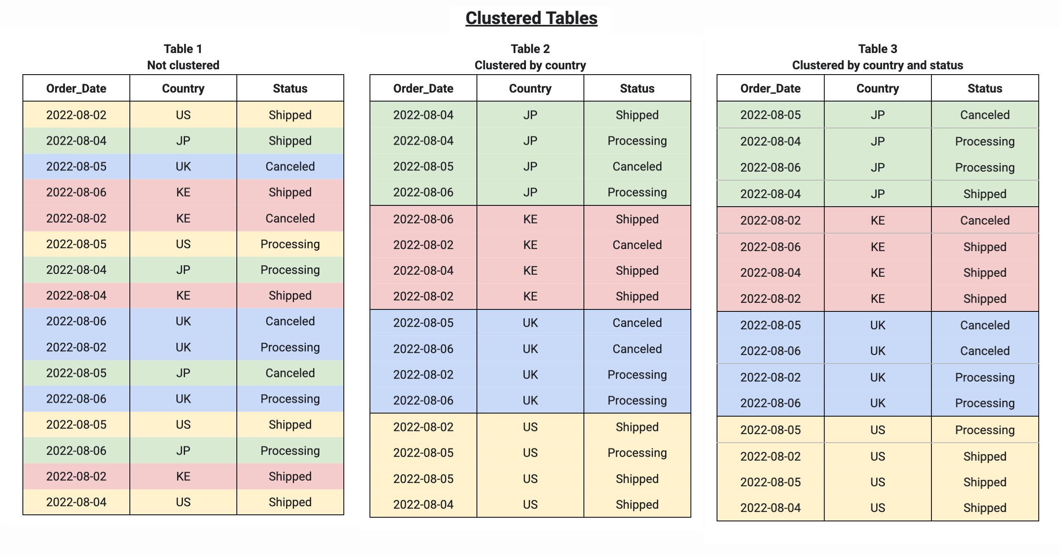
Clustered Tables
Clustered tables in BigQuery are tables that have a user-defined column sort order using clustered columns. Clustered tables can improve query performance and reduce query costs.
In BigQuery, a clustered column is a user-defined table property that sorts storage blocks based on the values in the clustered columns.
A clustered table maintains the sort properties in the context of each operation that modifies it.
Queries that filter or aggregate by the clustered columns only scan the relevant blocks based on the clustered columns, instead of the entire table or table partition.
When you cluster a table using multiple columns, the column order determines which columns take precedence when BigQuery sorts and groups the data into storage blocks, as seen in the following example.

Slide 12
When To..
Cluster
Partition
Unpartitioned tables larger than 64 MB are likely to benefit from clustering. Similarly, table partitions larger than 64 MB are also likely to benefit from clustering.
If your queries commonly filter on particular columns, clustering accelerates queries because the query only scans the blocks that match the filter.
If your queries filter on columns that have many distinct values (high cardinality), clustering accelerates these queries by providing BigQuery with detailed metadata for where to get input data.
Clustering enables your table's underlying storage blocks to be adaptively sized based on the size of the table.
You need a strict query cost estimate before you run a query.
You need to continually update your table but still want to take advantage of long-term storage pricing.
Partitioning enables each partition to be considered separately for eligibility for long term pricing.
If your table is not partitioned, then your entire table must not be edited for 90 consecutive days to be considered for long term pricing.

Slide 13
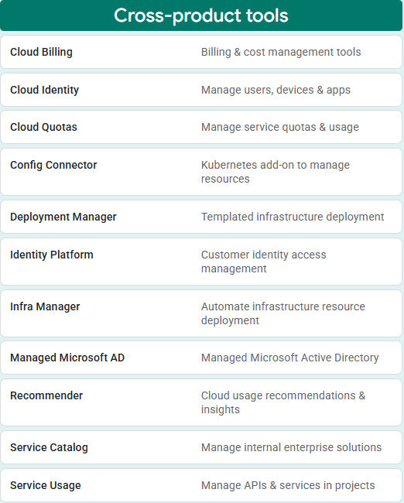
GCP Resources
Cross-product Tools

Slide 14
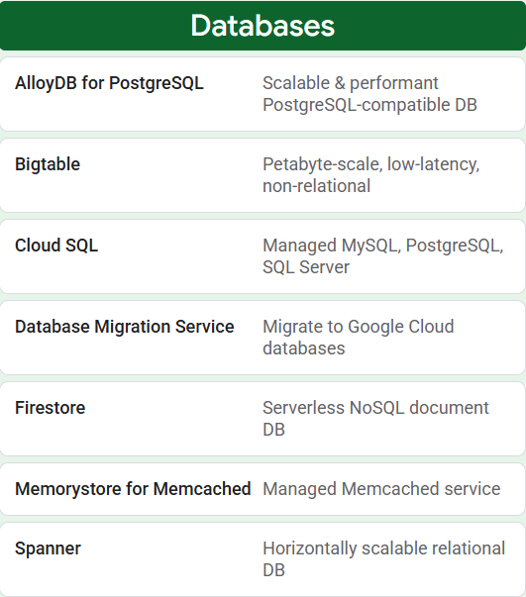
GCP Resources
Databases

Slide 15
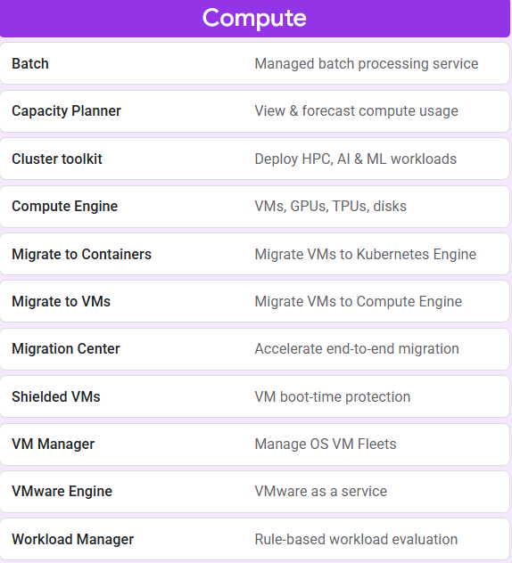
GCP Resources
Compute

Slide 16
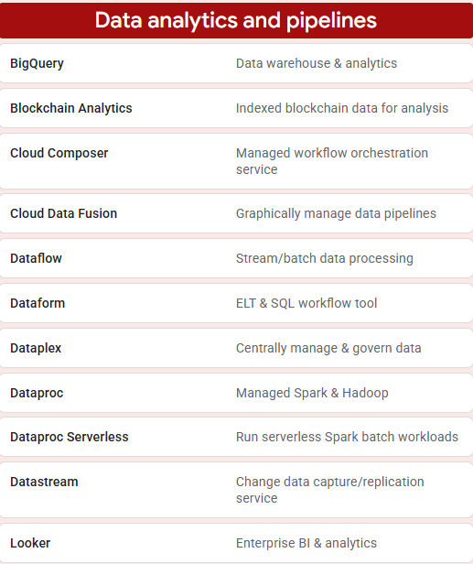
GCP Resources
Data Analytics & Pipeline

Slide 17
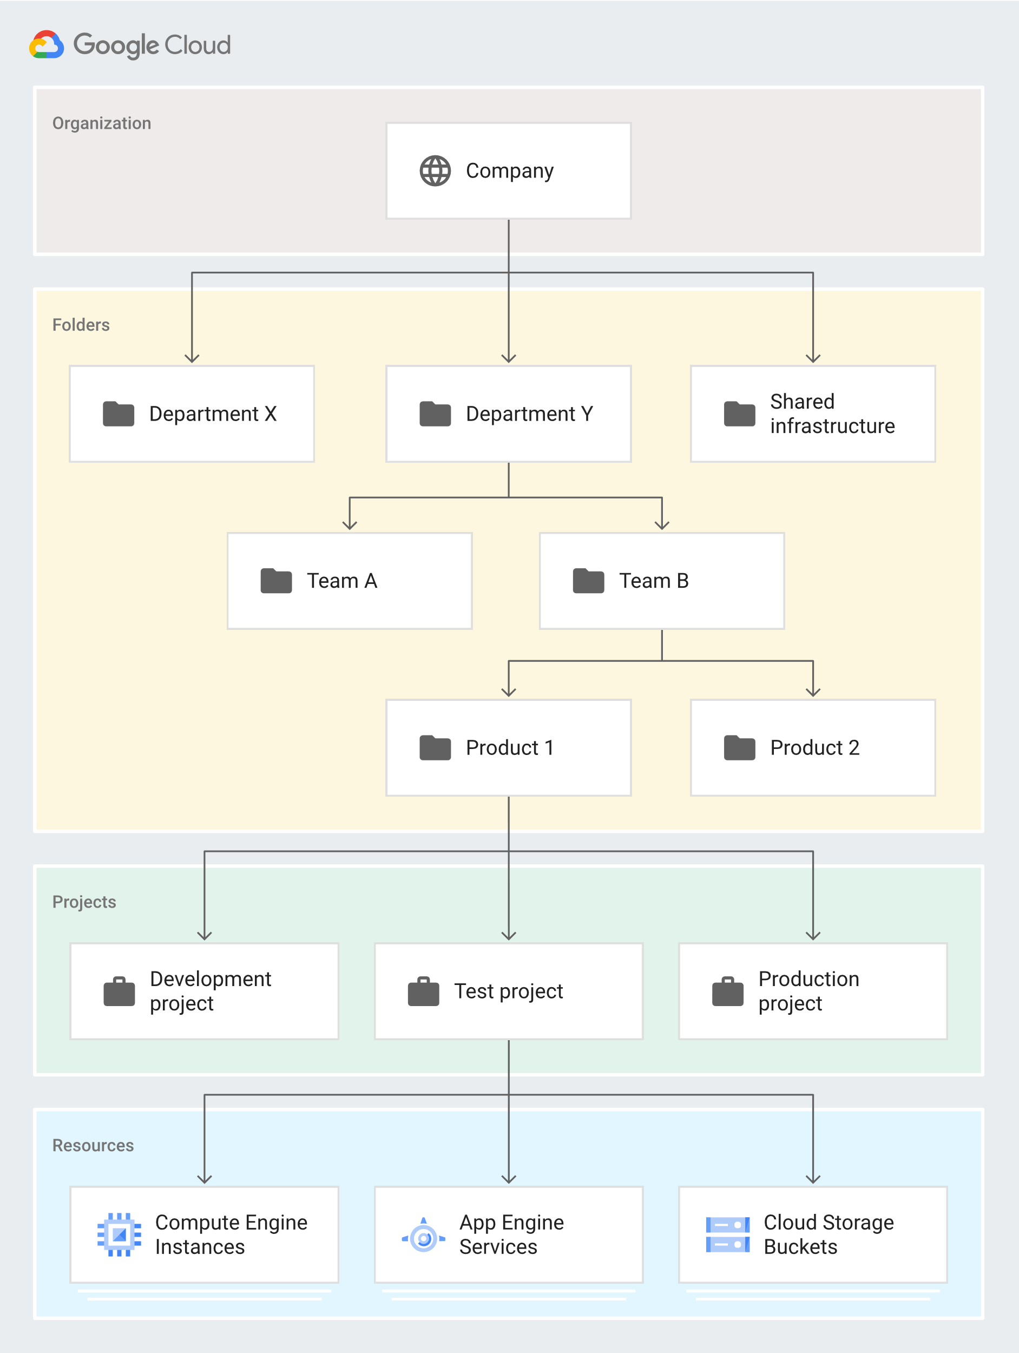
Resource Hierarchy
Overview

Slide 18



Resource Hierarchy
Organization resource
Folder resource
Project resource
The organization resource represents an organization (for example, a company) and is the root node in the Google Cloud resource hierarchy when present.
The organization resource is the hierarchical ancestor of folder and project resources.
The IAM access control policies applied on the organization resource apply throughout the hierarchy on all resources in the organization.
Folder resources optionally provide an additional grouping mechanism and isolation boundaries between projects.
They can be seen as sub-organizations within the organization resource.
Folder resources can be used to model different legal entities, departments, and teams within a company.
For example, a first level of folder resources could be used to represent the main departments in your organization resource.
The project resource is the base-level organizing entity.
Organization and folder resources may contain multiple projects.
A project resource is required to use Google Cloud, and forms the basis for creating, enabling, and using all Google Cloud services, managing APIs, enabling billing, adding and removing collaborators, and managing permissions.

Slide 19
IAM Policy Inheritance
IAM Stands for Identity Access Management
IAM lets you grant granular access to specific Google Cloud resources and helps prevent access to other resources
IAM lets you adopt the security principle of least privilege, which states that nobody should have more permissions than they require
IAM lets you control who (users) has what access (roles) to which resources by setting IAM policies on the resources.
You can set an IAM policy at the organization level, the folder level, the project level, or the resource level
Resources inherit the policies of the parent resource
If you set a policy at the organization level, it is inherited by all its child folder and project resources, and if you set a policy at the project level, it is inherited by all its child resources
The effective policy for a resource is the union of the policy set on the resource and the policy inherited from its ancestors
Resources inherit policies from the project, which inherit policies from the organization resource. Therefore, the organization-resource-level policies also apply at the resource level

Slide 20
Section 2:- BigQuery Architecture
Google BigQuery

Slide 21
Architecture
BigQuery’s serverless architecture decouples storage and compute and allows them to scale independently on demand.
Structure offers both immense flexibility and cost controls for customers because they don’t need to keep their expensive compute resources up and running all the time.
Under the hood, BigQuery employs a vast set of multi-tenant services driven by low-level Google infrastructure technologies like Dremel, Colossus, Jupiter and Borg.

Slide 22
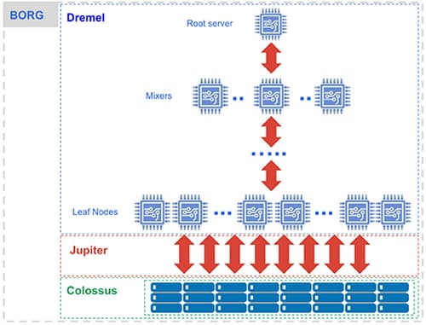
BigQuery Components
Compute is Dremel, a large multi-tenant cluster that executes SQL queries.
Storage is Colossus, Google’s global storage system.
Compute and storage talk to each other through the petabit Jupiter network.
BigQuery is orchestrated via Borg, Google’s precursor to Kubernetes.

Slide 23

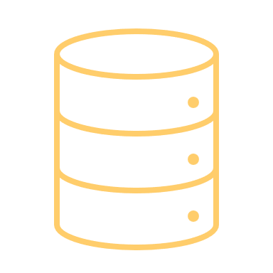

The Components
Dremel
Colossus
Jupiter & Borg
Dremel turns SQL queries into execution trees.
The leaves of the tree are called slots and do the heavy lifting of reading data from storage and any necessary computation.
The branches of the tree are ‘mixers’, which perform the aggregation.
BigQuery leverages the columnar storage format and compression algorithm to store data in Colossus, optimized for reading large amounts of structured data.
Colossus also handles replication, recovery (when disks crash) and distributed management (so there is no single point of failure).
Colossus allows BigQuery users to scale to dozens of petabytes of data stored seamlessly, without paying the penalty of attaching much more expensive compute resources as in traditional data warehouses.
In between storage and compute is ‘shuffle’, which takes advantage of Google’s Jupiter network to move data extremely rapidly from one place to another.
The mixers and slots are all run by Borg, which allocates hardware resources.

Slide 24
Section 3:- BigQuery Storage
Overview Of Storage

Slide 25
Storage -BigQuery Resource Model
BigQuery organizes data tables into units called datasets.
Datasets are scoped to a GCP project. These multiple scopes—project, dataset, and table—helps you structure your information logically.
Use multiple datasets to separate tables pertaining to different analytical domains, and you can use project-level scoping to isolate datasets from each other according to your business needs.

Slide 26
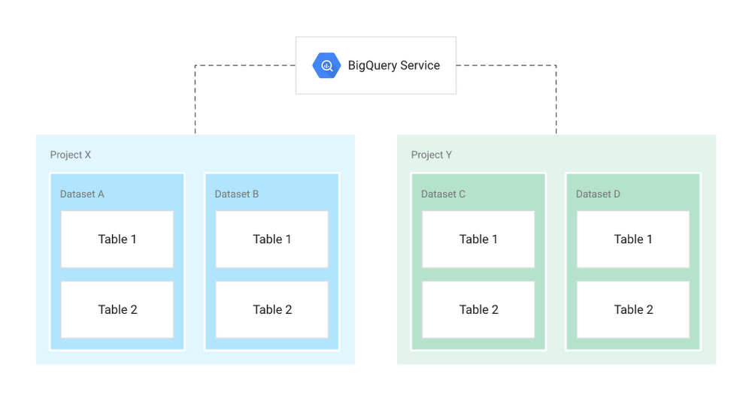
BigQuery Storage
Datasets
Collections of “related” tables/views together with labels and description
Allow storage access control at Dataset level
Define location of data i.e. multi-regional (US, EU) or regional (asia-northeast1)
Tables
Collections of columns and rows stored in managed storage
Defined by a schema with strongly-typed columns of values
Allow access control at Table level and Column level

Slide 27
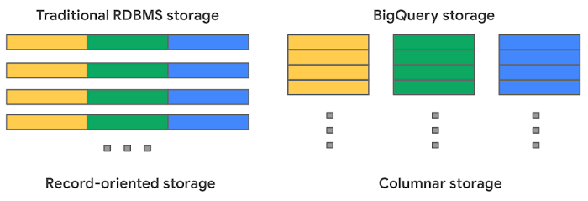
Traditional RDBMS Vs BigQuery
Traditional RDBMS
BigQuery
Traditional relational databases, like MySQL, store data row-by-row (record-oriented storage). This makes them good at transactional updates and OLTP (Online Transaction Processing) use cases.
BigQuery, on the other hand, uses columnar storage, where each column is stored in a separate file block. This makes BigQuery an ideal solution for OLAP (Online Analytical Processing) use cases.
You can stream (append) data easily to BigQuery tables and update or delete existing values. BigQuery supports mutations (INSERT, UPDATE, MERGE, DELETE) without limits.

Slide 28
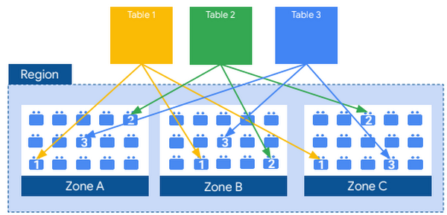
Columnar Storage
BigQuery uses variations and advancements on columnar storage.
Internally, BigQuery stores data in a proprietary columnar format called Capacitor, which has several benefits for data warehouse workloads.
Each column in the table is stored in a separate file block and all the columns are stored in a single capacitor file, which are compressed and encrypted on disk.
BigQuery uses query access patterns to determine the optimal number of physical shards and how data is encoded.
The actual persistence layer is provided by Google’s distributed file system, Colossus, where data is automatically compressed, encrypted, replicated, and distributed

Slide 29
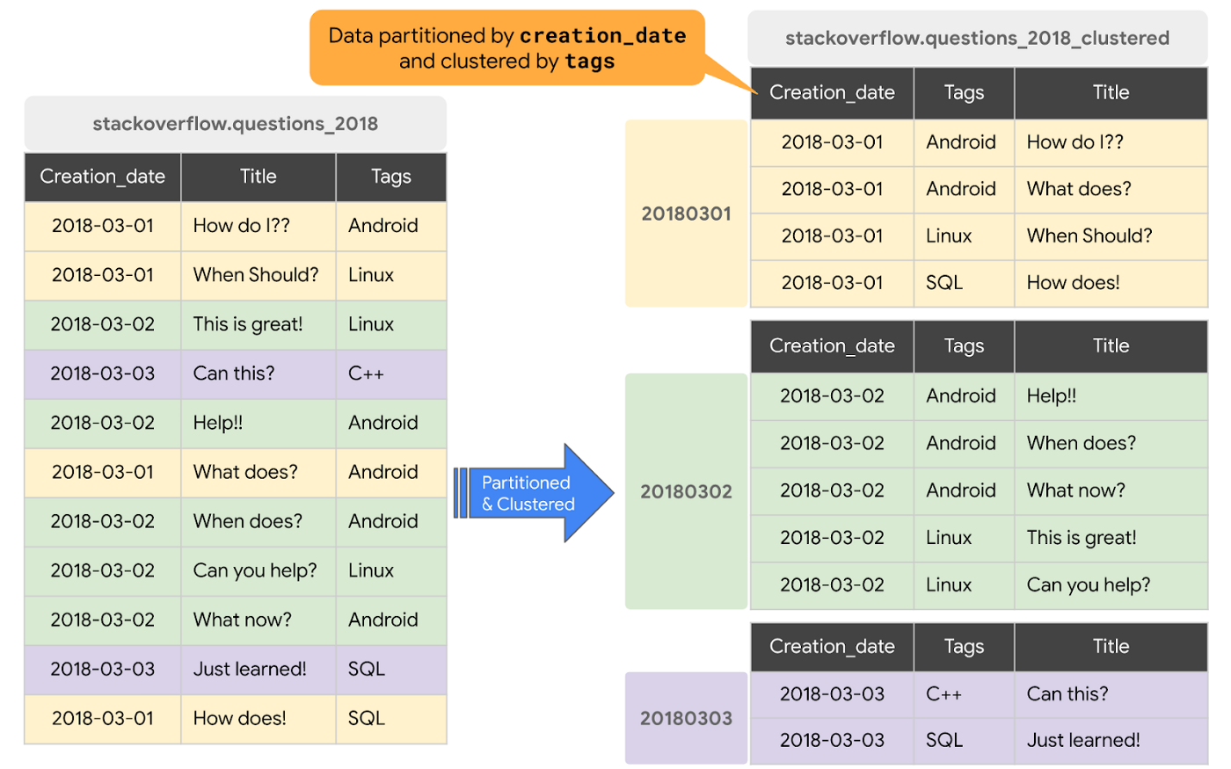
Partitioning And Clustering

Slide 30
Partitioning & Clustering
Partitioning
Clustering
A partitioned table is a special table that is divided into segments, called partitions, that make it easier to manage and query your data.
We can split large tables into many smaller partitions using data ingestion time or TIMESTAMP/DATE column or an INTEGER column.
Once slot workers read their data from disk, BigQuery can automatically determine more optimal data sharding and quickly repartition data using BigQuery’s in-memory shuffle service.
The table data is automatically organized based on the contents of one or more columns in the table’s schema.
The columns specified are used to collocate related data.
When data is written to a clustered table, BigQuery sorts the data using the values in the clustering columns.
The order of clustered columns determines the sort order of the data. When new data is added to a table or a specific partition, BigQuery performs automatic re-clustering in the background to restore the sort property of the table or partition. Auto re-clustering is completely free and autonomous for the users.

Slide 31
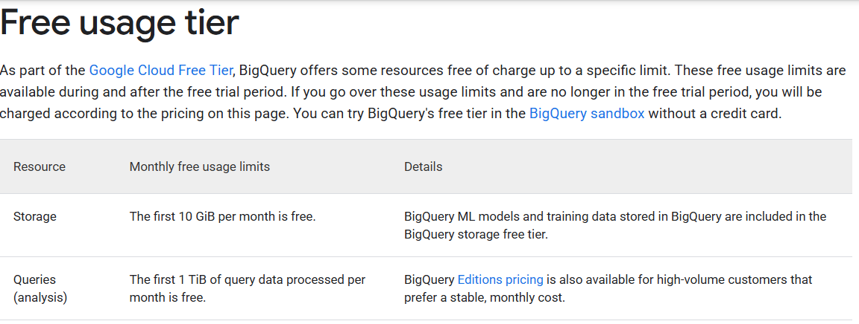
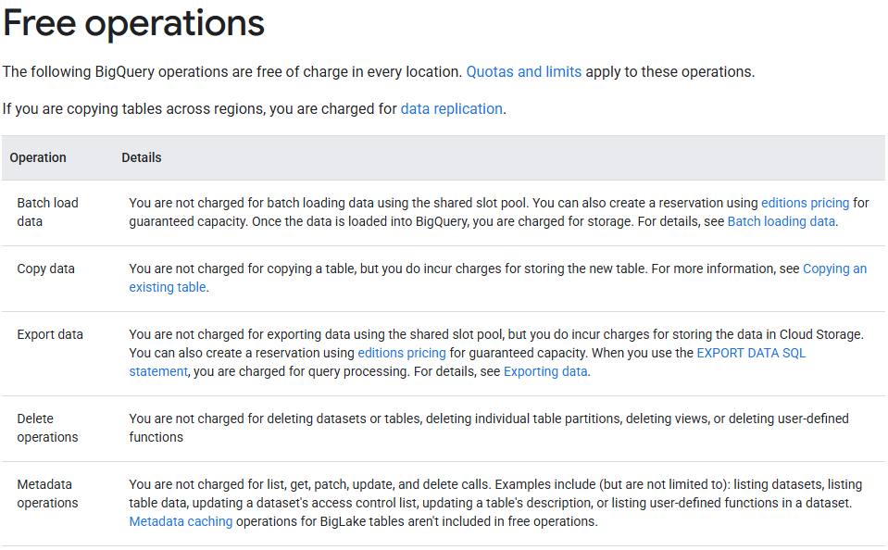
BigQuery Pricing
Compute pricing is the cost to process queries, including SQL queries, user-defined functions, scripts, and certain data manipulation language (DML) and data definition language (DDL) statements.
Storage pricing is the cost to store data that you load into BigQuery.
For more details please visit -
Pricing | BigQuery: Cloud Data Warehouse | Google Cloud
On Demand Pricing
Storage Pricing
Data Ingestion Pricing
Data Exctraction Pricing

Slide 32
THANK YOU!

